Slide 1
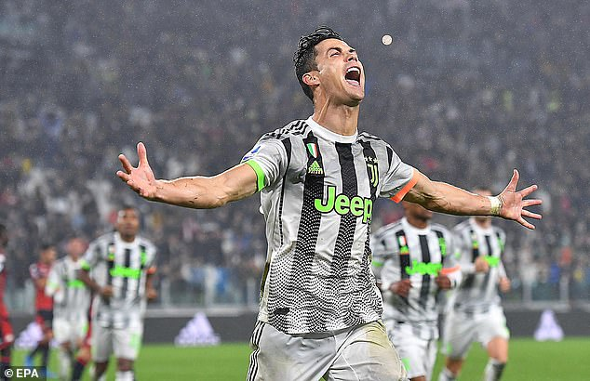


CRISTIANO RONALDO
Portuguese Footballer

Slide 2
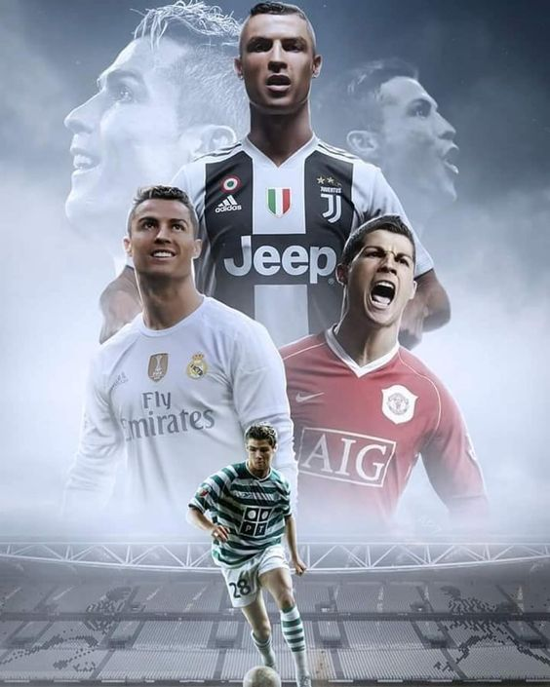
CONTENTS Page
Cristiano Ronaldo: "I'd be an idiot not to learn from Scholes and Giggs“…….....1
Cristiano Ronaldo Biography(1985–)………………………………………………………………………2
Cristiano: "You need intelligence to stay at the very top“…………………………3
Cristiano Ronaldo Soccer Player stats………………………………………………4
A player of Cristiano Ronaldo’s calibre can never be replaced………………………………..5
Career achievements by Cristiano Ronaldo…………………………………………………………….6
List of Mens ballon dior winners…………………………………………………….7

Slide 3
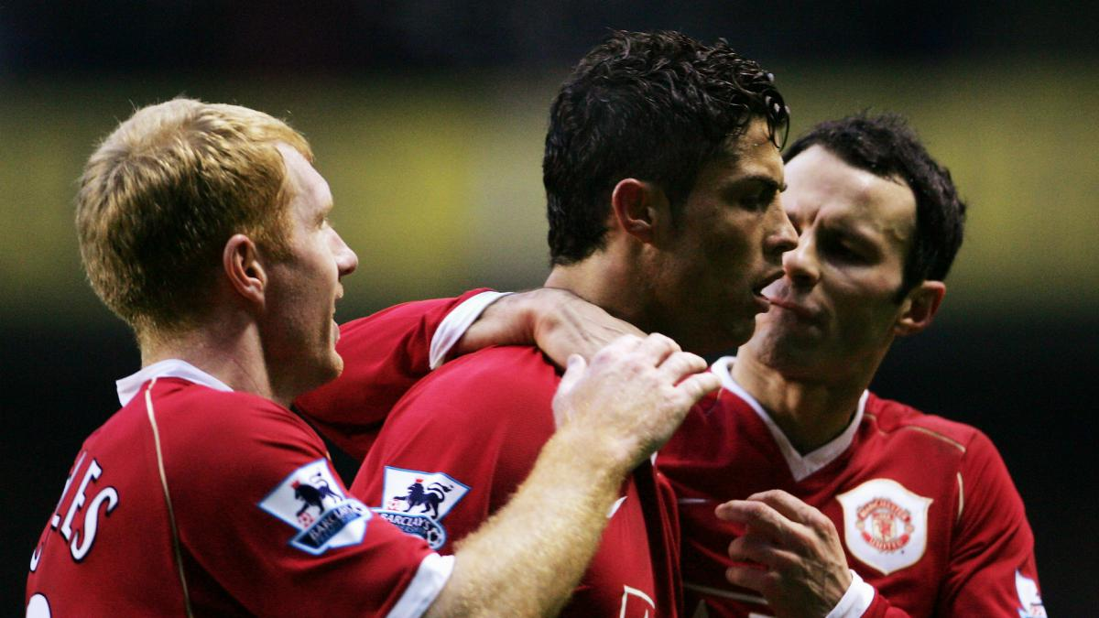
Cristiano Ronaldo says he would have been a fool if he failed to learn from the likes of Paul Scholes and Ryan Giggs during his early days at Manchester United. The Portugal international made his name at Old Trafford after joining the Premier League club from Sporting Clube de Portugal in 2003 at the age of 18. He scored 118 goals in six seasons with United and has since starred for Real Madrid and current side Juventus, recently netting his 700th career goal for club and country.
1
1

Slide 4
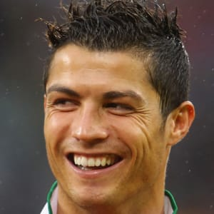
Cristiano Ronaldo is a professional soccer player who has set records while playing for the Manchester United, Real Madrid and Juventus clubs, as well as the Portuguese national team.
Who Is Cristiano Ronaldo?
Cristiano Ronaldo dos Santos Aveiro is a Portuguese soccer superstar. By 2003 — when he was just 16 years old — Manchester United paid £12 million (over $14 million U.S. dollars) to sign him, a record fee for a player of his age.
In the 2004 FA Cup final, Ronaldo scored Manchester's first three goals and helped them capture the championship. He set a franchise record for goals scored in 2008, before Real Madrid paid a record $131 million for his services the following year.
2

Slide 5
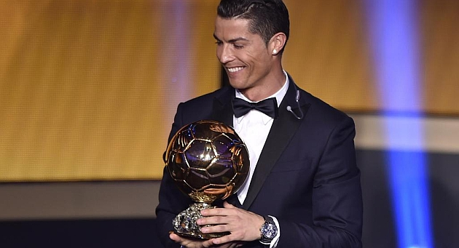
"You have to be intelligent to stay at the top," the Portuguese player declared. He went on to say explain other keys to his longevity and success and how he aims to feel as young as he can. At 34, he is still defying many.
Cristiano has tended to shy away from questions about the end of his playing career, but confirmed to the French outlet that he will switch off for at least a while when the time eventually comes to hang up his boots.
"When I finish my career, I will disconnect from everything," the Real Madrid legend concluded.
3

Slide 6
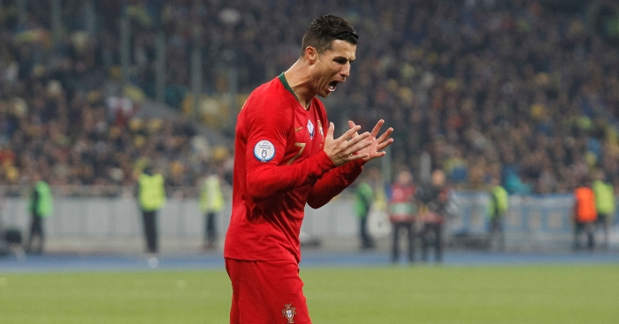
Portugal may have lost their big Euro 2020 qualifier in Ukraine, but that didn’t stop Cristiano Ronaldo reaching another milestone.
The Juventus forward scored his 700th career goal in Kiev, halving the deficit from the penalty spot to edge closer to 100 international goals. His 700 are comprised of five for Sporting Lisbon, 118 for Manchester United, 450 for Real Madrid, 32 for Juventus and 95 for Portugal.
If that doesn’t sound impressive enough, we’ve picked out a few stats to give an idea of just how far ahead of the curve he is.
– Ronaldo is now just 14 goals shy of equalling the record of Ali Daei, who scored 109 time in 149 games for Iran, as the highest international goalscorer in history.
– Only five other players in history have scored 700 or more goals; Brazilian greats Pelé and Romário, plus Josef Bican, Ferenc Puskas and Gerd Muller.
4

Slide 7
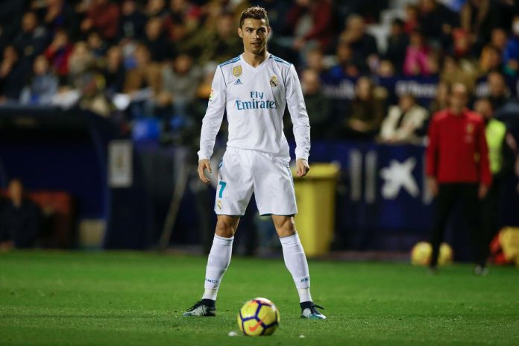
Cristiano Ronaldo is arguably the greatest player to step onto the football pitch. He has won almost everything on the individual and club level. His scoring records are inhumane.
Real Madrid can never replace a player who scored 451 goals in just 438 games for them. Cristiano Ronaldo is from another planet and his Real Madrid stats rightly prove so.
Players like Cristiano Ronaldo and Lionel Messi are born once in a century who take the football pitch by storm. The two are way above the level of all the other footballers. No one comes near to their goalscoring stats.
According to GiveMeSport, between 2009 and 2018, the Spanish club played 519 games and scored in all but 46 of them – failing to find the net in just 8.86% of matches.
Yet since Ronaldo left for Juventus, Madrid have played 71 times and failed to score in 17 – which is 23.94% of their matches.
5

Slide 8
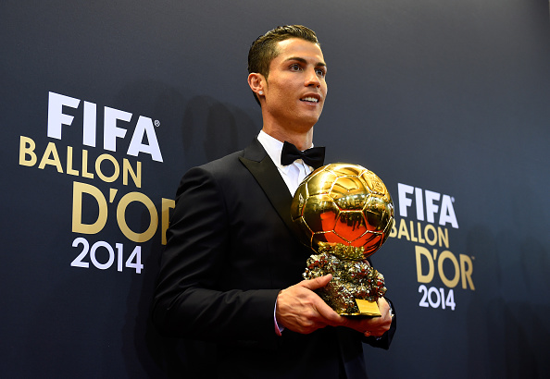
Over the course of his career, Portuguese footballer Cristiano Ronaldo, has received five Ballon d'Or awards,^{[a]} the most for a European player and is tied for most all-time. Widely regarded as one of the greatest players of all time,^{[1][2][3]} Ronaldo holds the record for most goals in the UEFA Champions League (127), the UEFA European Championship (9), the FIFA Club World Cup (7), and the UEFA Nations League Finals (3), as well as most goals scored in a UEFA Champions League season (17). He has scored 702 senior career goals for club and country. Moreover, he is also the first player in history to win four European Golden Shoes.
Collectively, Ronaldo has won between 28 and 31 trophies in his career,^{[b]} including six league titles, five European Cups and one European Championship. He has also attained 16 titles from friendly competitions. All in all he had won over 300 trophies and medals by May 2019, with some of them dating back to his childhood.^{[8]}
6

Slide 9
year | Player | Nationality | club
2018 | Luka Modric | Croatia | Real Madrid
2017 | Cristiano Ronaldo | Portugal | Real Madrid
2016 | Cristiano Ronaldo | Portugal | Real Madrid
2015 | Lionel Messi | Argentina | Barcelona
2014 | Cristiano Ronaldo | Portugal | Real Madrid
2013 | Cristiano Ronaldo | Portugal | Real Madrid
2012 | Lionel Messi | Argentina | Barcelona
2011 | Lionel Messi | Argentina | Barcelona
2010 | Lionel Messi | Argentina | Barcelona
2009 | Lionel Messi | Argentina | Barcelona
2008 | Cristiano Ronaldo | Portugal | Manchester United
2007 | Kaká | Brazil | Milan
2006 | Fabio Cannavaro | Italy | Real Madrid
2005 | Ronaldinho | Brazil | Barcelona
2004 | Andriy Shevchenko | Ukrain | Milan
2003 | Pavel Nedvěd | Czech Republic | Juventus
2002 | Ronaldo | Brazil | Real Madrid
2001 | Michael Owen | England | Liverpool
7

